Slide 1
Information systems in Global business today
Chapter - I

Slide 2
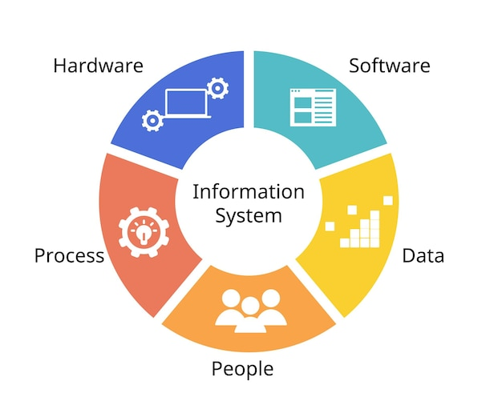
Introduction to Information Systems
What is an Information System?
Definition: An Information System (IS) is a combination of people, process, hardware, software, networks, data resources, and policies that stores, retrieves, transforms, and shares information within
an organization.

Slide 3
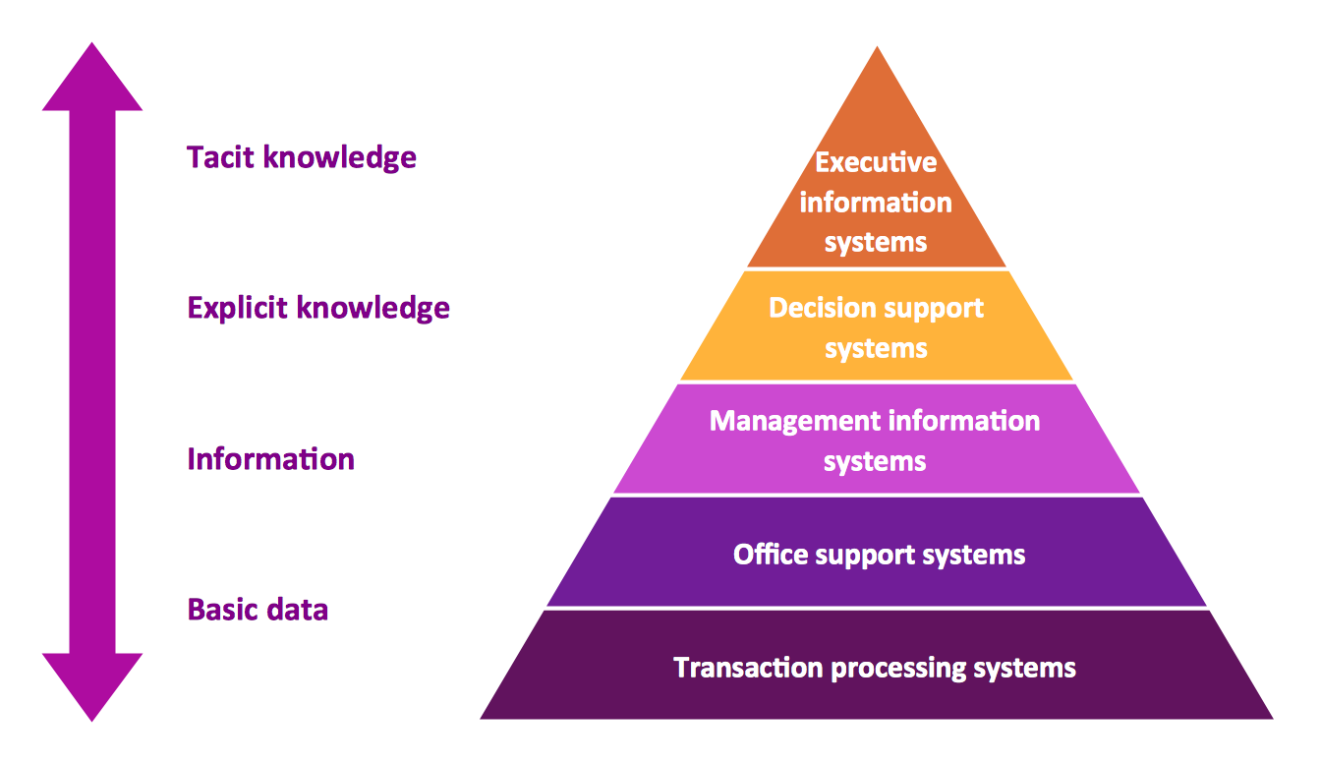
Information System Knowledge Framework
Framework of IS Knowledge for Business Professionals
This framework
outlines major
areas of knowledge
for business
professionals
working
with IS
Note : Tacit knowledge is the
type of knowledge that is
personal, experience-based,
and often difficult to
communicate or formalize

Slide 4
Key Areas of Information Systems Knowledge
Foundation Concepts
Understand the behavioral, technical, and managerial basics of Information Systems and how they support business functions.
Information Technologies
Covers core IT components including hardware, software, networking, databases, and data management systems.
Business Applications
Focuses on how IS is used to support business operations, decision-making, and gaining a competitive advantage.
Development Processes
Involves the planning, design, development, and implementation of information systems to solve business problems.
Management Challenges
Addresses the ethical, strategic, and operational challenges of managing IT across all levels of a business.

Slide 5
The fundamental Roles of IS in Business
Information Systems (IS) play three essential roles in enhancing business performance and competitiveness.
  a. Support of business processes and operations.
  b. Support of decision making
  c. Support of strategies for competitive advantage.

Slide 6
Support of Business Processes and Operations
Description: IS enables efficient day-to-day operations by automating routine tasks, managing workflows, and ensuring timely data processing.
Examples: Inventory management, order processing, customer service systems.

Slide 7
Support of Decision Making
Description: IS provides employees and managers with data insights and analytical tools to make informed decisions.
Examples: Business intelligence, data analytics, reporting tools.

Slide 8
Support of Strategies for Competitive Advantage
Description: IS helps businesses gain an edge over competitors by optimizing operations, enhancing customer engagement, and enabling innovation.
Examples: Customer relationship management (CRM), supply chain optimization, e-commerce platforms.

Slide 9
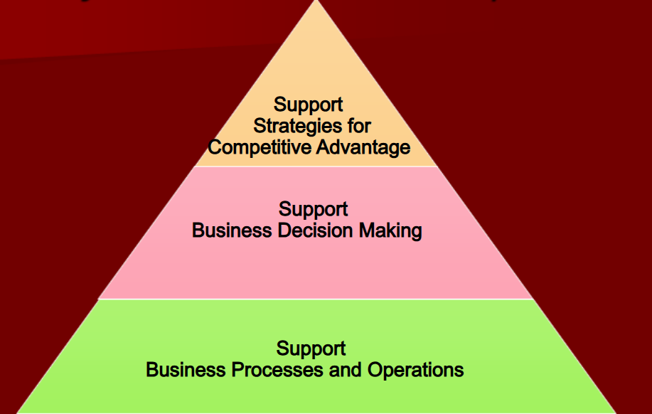
Fig : The three fundamental roles of the business applications of information systems.

Slide 10
The Role of E-Business in Business
E-business encompasses any online exchange of value, including information, money, resources, and services. It supports business activities through digital channels.
Primary Functions of E-Business Applications:
  Reengineer Internal Business Processes:
  Implement E-Commerce Systems:
  Promote Enterprise Collaboration:

Slide 11
Reengineer Internal Business Processes:
Description: E-business tools streamline and automate internal workflows, improving efficiency and productivity.
Example: Digital document management, automated inventory tracking.

Slide 12
Implement E-Commerce Systems:
Description: Provides platforms for seamless online transactions with customers and suppliers, broadening market reach and accessibility.
Example: Online stores, B2B e-commerce platforms.

Slide 13
Promote Enterprise Collaboration:
Description: Facilitates communication and collaboration across teams and workgroups, enabling effective project management and innovation.
Example: Shared workspaces, digital collaboration tools like Slack or Microsoft Teams.

Slide 14
Role of Information systems in business today
Enhancing Efficiency: Automates processes, reducing costs and increasing productivity.
Data-Driven Decision Making: Provides real-time data and analytics to guide strategic decisions.
Improving Customer Experience: Personalizes interactions, builds loyalty, and increases satisfaction.
Gaining Competitive Advantage: Helps businesses innovate and stay ahead of competitors.
Supporting Collaboration: Facilitates teamwork across departments and locations.
Optimizing Supply Chains: Increases visibility, reduces lead times, and enhances order fulfillment.
Ensuring Scalability: Adapts to business growth with flexible, scalable solutions.
Maintaining Compliance and Security: Protects data, supports regulatory compliance, and manages risk.

Slide 15
Globalization: Challenges and Opportunities for Businesses
Challenges of Globalization
Cultural Differences: Language, customs, and cultural preferences can create barriers in communication and marketing.
Regulatory and Compliance Issues: Navigating different laws, standards, and regulatory frameworks across countries can be complex and costly.
Supply Chain and Logistics Complexity: Managing global supply chains with varying infrastructure, time zones, and currency exchanges can pose logistical challenges.
Data Security and Privacy Concerns: Protecting customer data across different jurisdictions with distinct privacy laws requires stringent security measures.
Workforce Management: Coordinating teams across diverse geographic locations and ensuring consistent training and management can be challenging.

Slide 16
Globalization: Challenges and Opportunities for Businesses
Opportunities of Globalization:
Expanded Market Reach: Access to a broader, global customer base allows for increased revenue and brand exposure.
Diverse Talent Pool: Global hiring enables companies to access specialized skills and diverse perspectives, fostering innovation.
Cost Efficiency: Operating in regions with lower production costs can enhance cost-effectiveness and profit margins.
Innovation and Knowledge Sharing: Exposure to diverse ideas and practices from different cultures encourages creativity and knowledge exchange.
Competitive Advantage: Early entry into emerging markets provides companies with a strong competitive edge and potential market dominance.

Slide 17
Strategic Business Objectives of Information Systems
Improving Efficiency and Productivity:
Description: Information systems streamline operations by automating tasks, reducing manual errors, and optimizing workflows, leading to higher efficiency.
Example: Automation of supply chain management, reducing inventory costs, and improving order fulfillment speed.

Slide 18
Enhancing Decision Making:
Description: IS provide accurate and timely data for decision-making at all levels of the organization, helping managers make informed strategic decisions.
Example: Business intelligence tools, data analytics dashboards, and reporting systems for better decision support.

Slide 19
Gaining Competitive Advantage:
Description: Information systems enable businesses to gain a competitive edge by leveraging technology to offer better services, faster responses, or unique business models.
Example: E-commerce platforms, personalized customer experiences, and digital marketing strategies.

Slide 20
Supporting Innovation:
Description: IS foster innovation by facilitating the development of new products, services, or business models, supporting long-term growth and adaptation to market changes.
Example: Product innovation through R&D systems, cloud-based collaboration tools for creative teams.

Slide 21
Enabling Global Reach:
Description: Information systems allow businesses to expand their operations globally by connecting employees, customers, and partners across geographical boundaries.
Example: E-commerce platforms, cloud computing, and cross-border communication tools.

Slide 22
Ensuring Customer Satisfaction:
Description: By leveraging IS, businesses can improve customer service, personalize interactions, and enhance the overall customer experience.
Example: Customer relationship management (CRM) systems, chatbots for real-time support, and loyalty programs.

Slide 23
Management Information System (MIS)
A Management Information System (MIS) is a structured, computerized system designed to collect, process, store, and disseminate information to support decision-making, coordination, control, analysis, and visualization in an organization. MIS provides timely and relevant data, typically in the form of reports and summaries, enabling managers to plan, monitor, and manage operations effectively

Slide 24
Management Information System (MIS)
The key components of an MIS include people, processes, data, software, and hardware, all working together to transform raw data into meaningful insights that help organizations improve efficiency, productivity, and decision-making.

Slide 25
Business perspective of information system
From a business perspective, information systems (IS) are not just technical tools but critical enablers for achieving strategic goals and maintaining
Here are some key perspectives on how businesses view information systems
  Operational Efficiency
  Decision Support
  Customer Relationship Management (CRM)
  Competitive Advantage
  Collaboration and Communication
  Supply Chain Management (SCM)
  Scalability and Flexibility
  Compliance and Risk Management

Slide 26
Operational Efficiency
Streamlines routine tasks, reducing manual effort and error.
Leads to cost savings, faster processing, and higher productivity.
Decision Support
Provides real-time data and analytics for informed decision-making.
Helps predict outcomes and reduce business risks.
Customer Relationship Management (CRM)
Collects and organizes customer data for personalized experiences.
Enhances satisfaction, loyalty, and customer lifecycle tracking.

Slide 27
Competitive Advantage
Offers insights to innovate and optimize offerings.
Identifies market opportunities ahead of competitors.
Collaboration and Communication
Facilitates internal communication across departments.
Enables collaborative workflows, regardless of location.
Supply Chain Management (SCM)
Increases supply chain visibility and coordination.
Optimizes inventory, reduces lead times, and improves fulfillment.

Slide 28
Scalability and Flexibility
Supports scaling operations with minimal disruption.
Cloud-based IS allow easy adjustments to meet demand.
Compliance and Risk Management
Ensures regulatory compliance and data security.
Manages risks with data access tracking and audit trails.

